Slide 1

DISPLAy BOOKSHELVES

Slide 2
TEAM MEMBERS OF DOMINATORS
Shubham Mishra – 890843
Rama Chandra Prasad Chakali – 890460
Shubham Lokare – 890247
Rohit Jujaray – 891070
Goje Niharika - 890161

Slide 3
Introduction:
To build a good application, which is reliable, scalable and maintainable, it is important for QA teams to adopt proven design techniques and good coding standards.
In the below presentation ,we will under the working of the website "Urban Ladder" to display the bookshelves.
We will also know about the technologies and displaying screenshots that are used to know the working of the site.

Slide 4
REQUIREMENTS
REQUIREMENT-1:
a)Search for "Bookshelves“. b) Select the "Storage type" . c) Check the "Exclude out of stock" checkbox.
REQUIREMENT-2:
a)Select "Collections". b) Check the dropdown list & their Sub-menu.
c)Select being at home from collections and display all the list.
REQUIREMENT-3:
a)Select "Gift Cards“.
b) Check whether the user is able to choose an occasion and Customize their gift card.
REQUIREMENT-4:
a)Check if the error message is displayed when entered the invalid email-id.
REQUIREMENT-5:
a) Display first three highly recommended study chairs with their prices.

Slide 5
Technologies Used:
1.Selenium for testing web application.
2.TestNG for unit testing.
3.Apache POI for Page Object Model.
4.Maven for building the project.
5.Jenkins for Continuous integrations.
6.MS Excel for manage data.

Slide 6
TEST CASE-1
1. Launching website.
2. Search button is disable when field is empty.
3. Keeping the text box empty.
4. Searching for Bookshelves.
5. Clicking the Excluding out of stock button.
6. Searching for bookshelves.

Slide 7
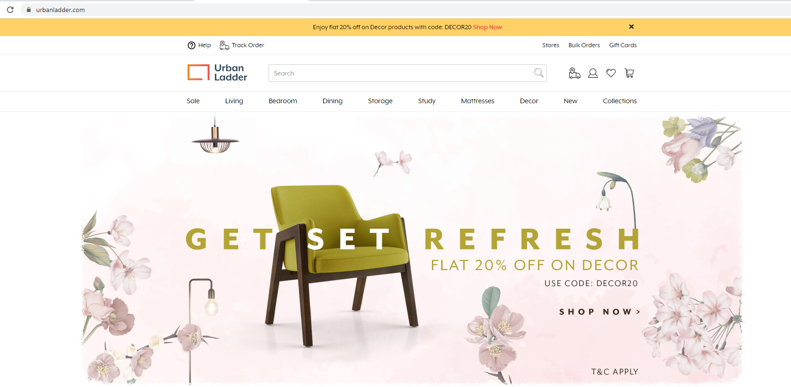
Firstly, we validate the site ” https://urbanladder.com “. This is the main page of the website “Urban Ladder”.

Slide 8
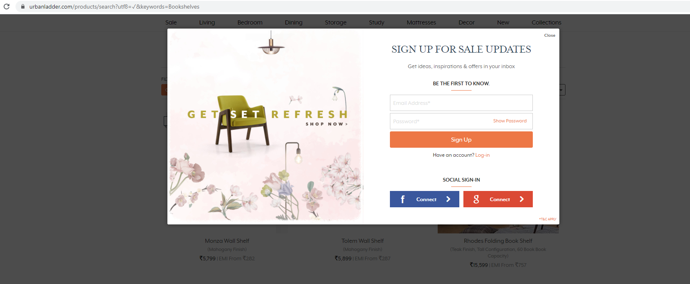
As we are on the website there is a log in pop up which has to be closed.

Slide 9
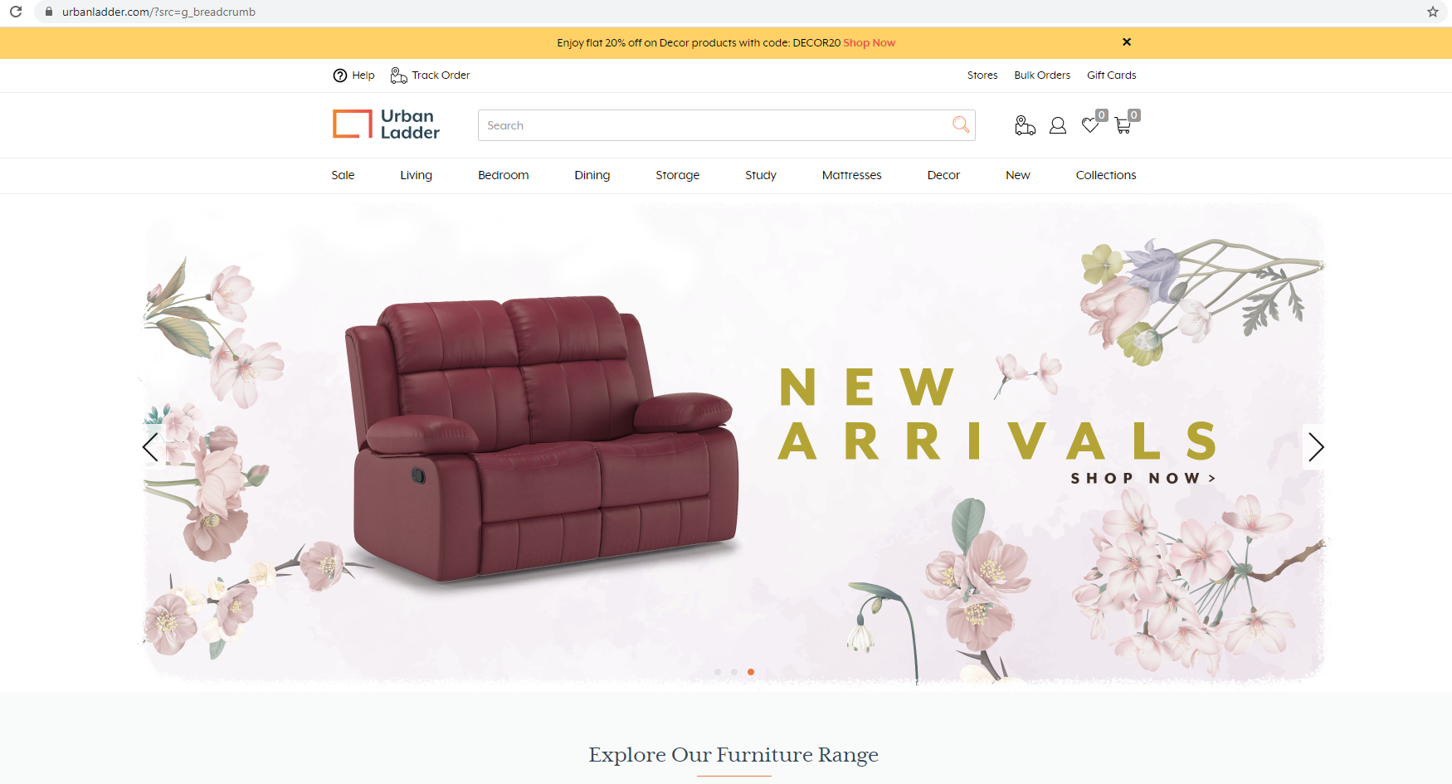
We will check weather the search button is working by keeping the text box empty and we notice that the search button doesn’t work.

Slide 10
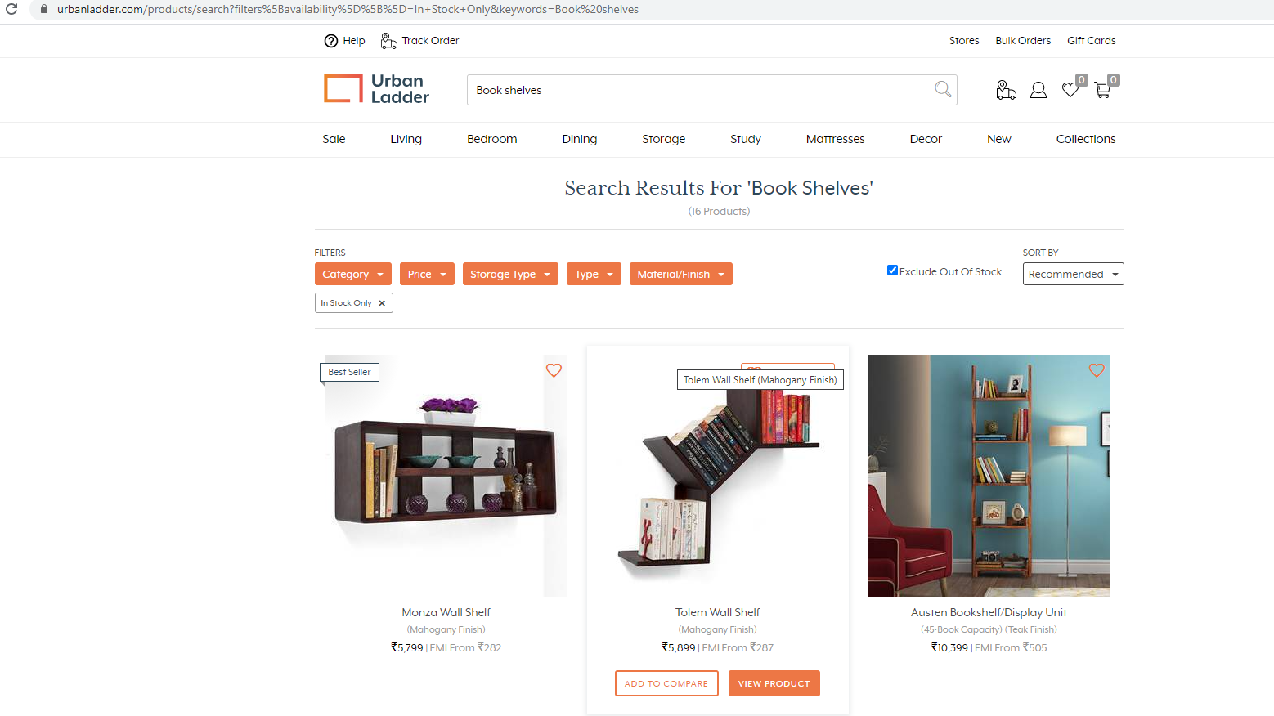
Search for ”Bookshelves”. Select storage type and check on “Exclude out of stock” is working or no. And then the values of first three bookshelves below 15,000/- are taken and displayed into the console.

Slide 11
TEST CASE-2
Search for collections.
Checking the dropdown list.
Selecting being at home from collections.
Displaying the sub menu list.

Slide 12
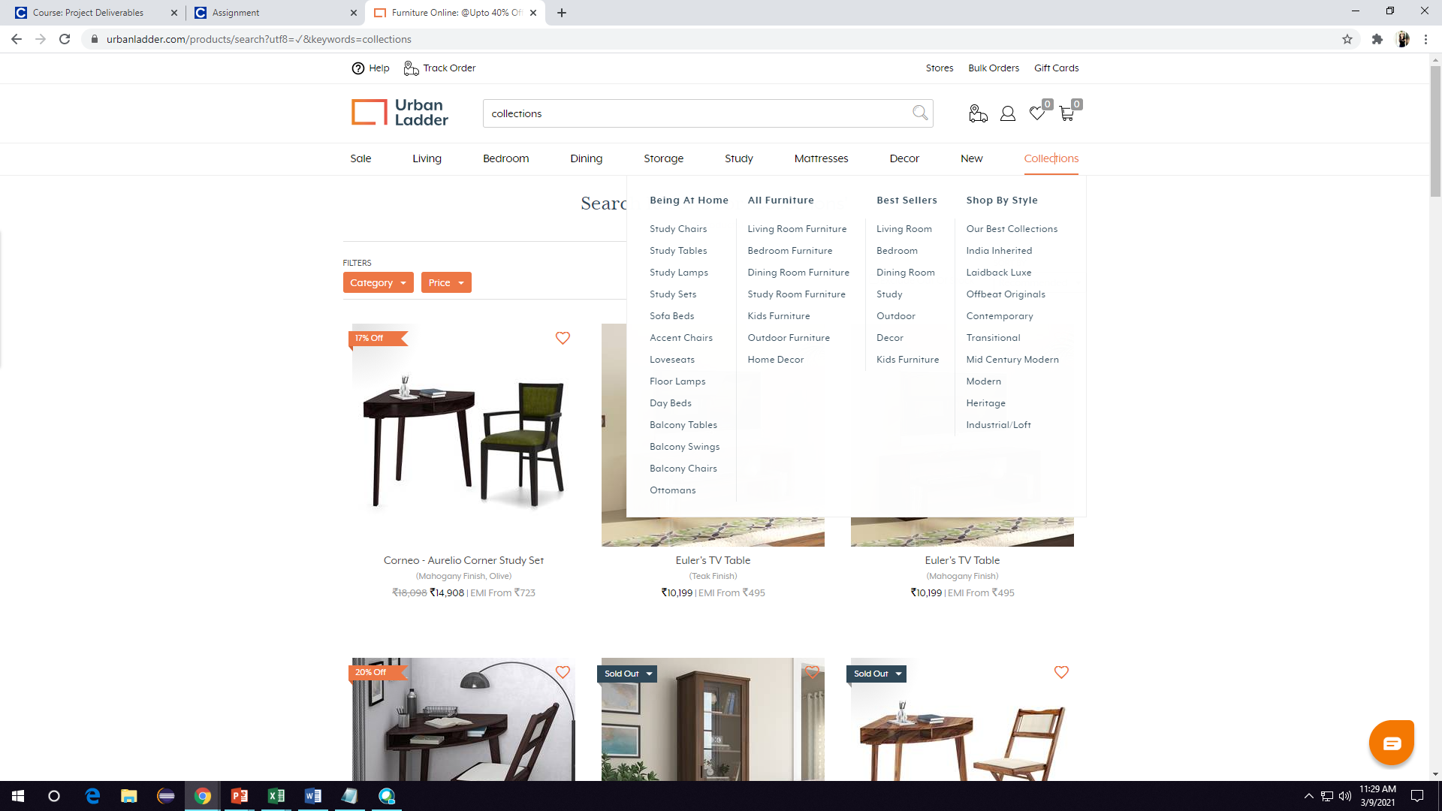
In this scenario, we firstly search for “Collections” and check weather the drop down list is working or not .

Slide 13
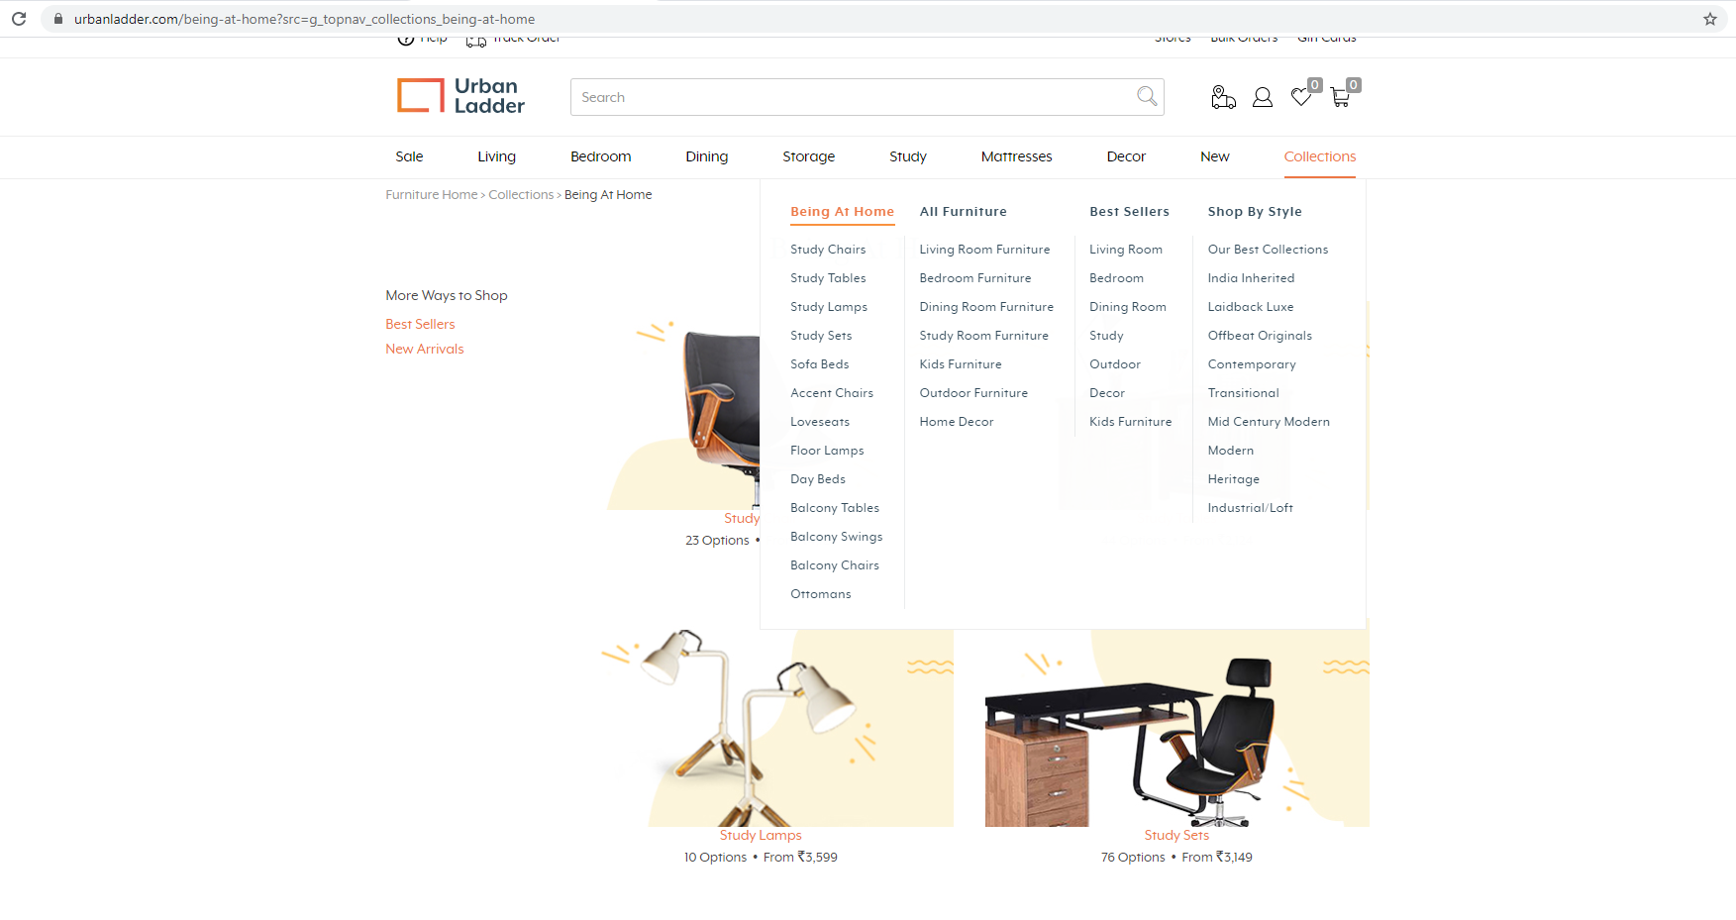
Next , we check for “Being at home” from collections. The sub menu list from ‘Being at home’ are displayed .

Slide 14
TEST CASE-3 PART-1
Validate Gift cards.
Selecting the occasion
Entering the amount.
Clicking on the Next button.

Slide 15
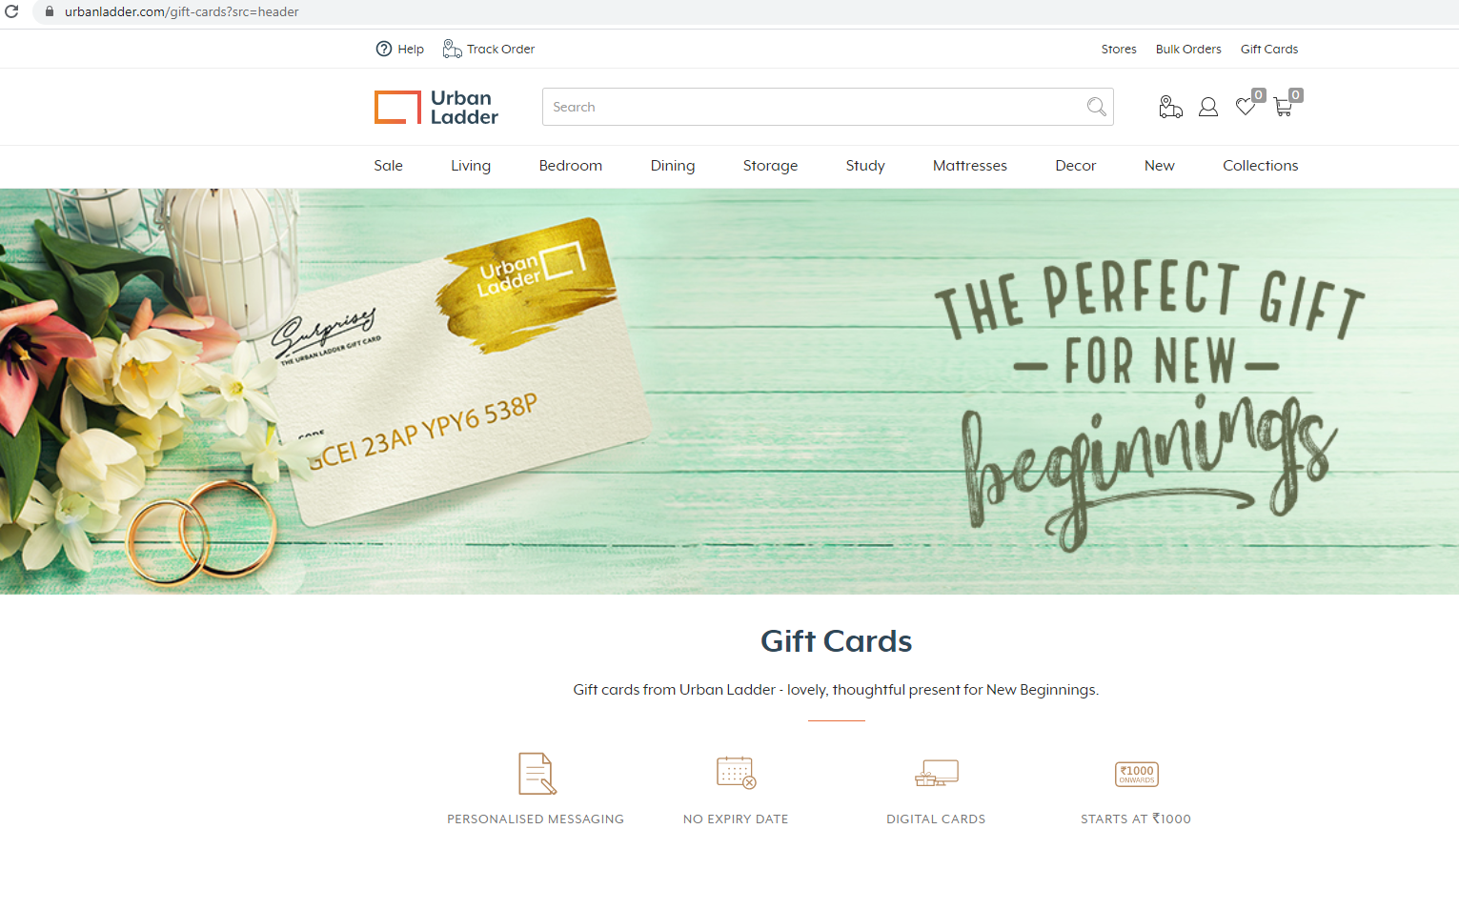
Firstly, we select “Gift cards” option from the home page.

Slide 16
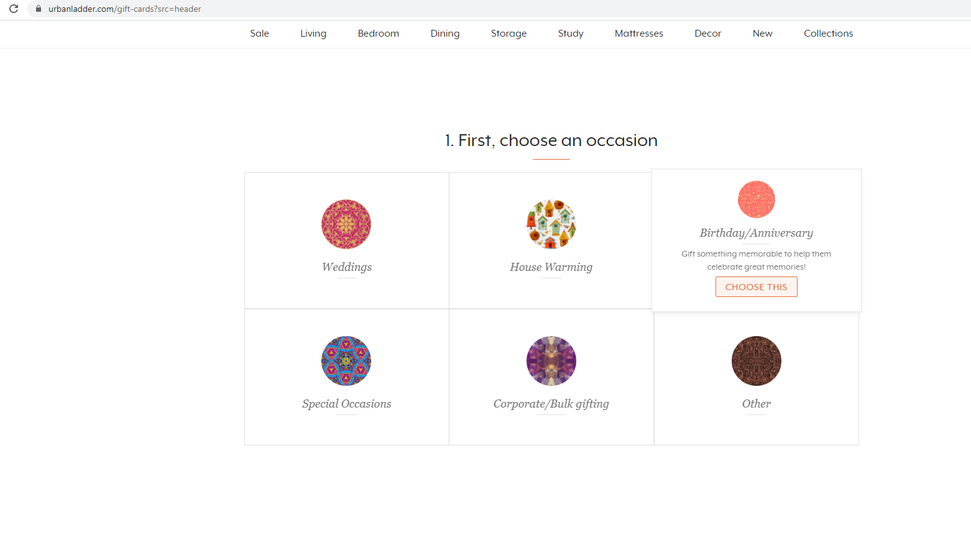
Select the occasion from the below options. We are selecting “Birthday/Anniversary” as our occasion.

Slide 17
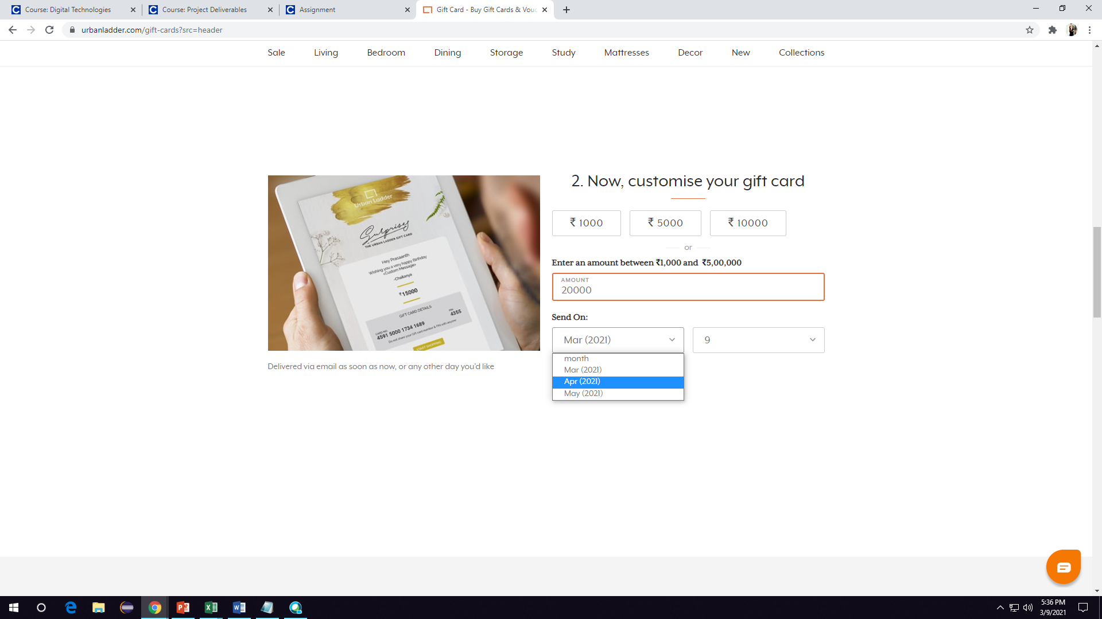
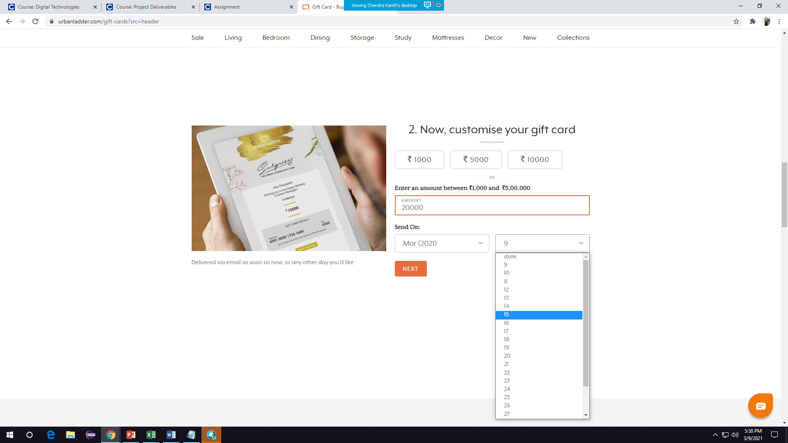
The date to send should be selected from the drop down list. We should be able to select the date and month from thedrop down list.

Slide 18
TEST CASE-3 PART-2
Entering invalid email address data.
Display the error message.

Slide 19
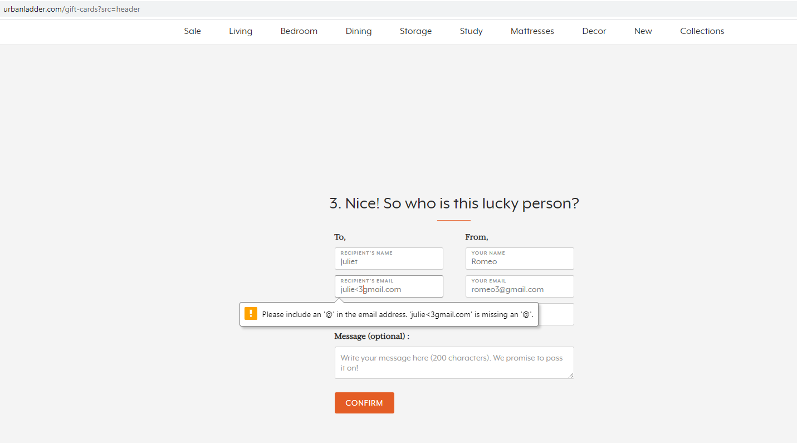
In this scenario, we try to give an invalid email and this time we have an error displayed according to the error. In the below invalid email we have given a special character and missed @ symbol. The error we get is “Please include an ‘@’ in the email address. ‘Julie<3gmail.com’ is missing an ‘@’.”.

Slide 20
TEST CASE-4
1. Search for study chairs.
2. Display highly suggested study chairs with their prices.

Slide 21
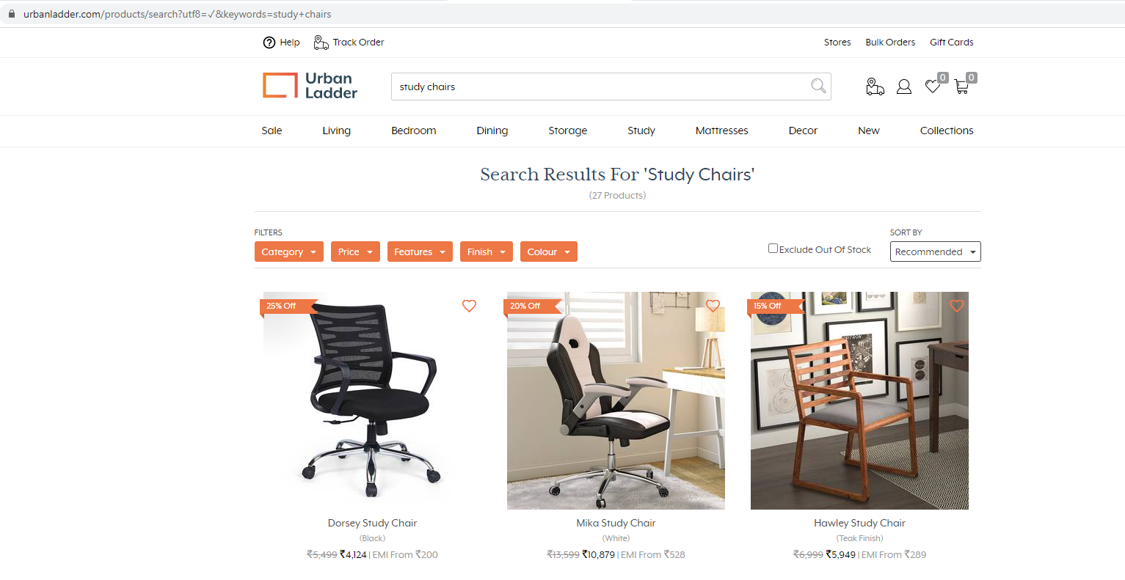
In this case, we search for “Study chairs”. We display the highly recommended first three study chairs with their prices.

Slide 22


